Slide 1
Project Report
V Sriram Panchamukhi
23EEB0A15
EEE-A

Slide 2
Table of contents
01
02
03
04
Introduction
Milestones
Analysis
Conclusion

Slide 3
Introduction
The project aims to create a Python-based Nine Men’s Morris game in player vs. player mode using Pygame. Featuring an intuitive GUI, players can place, move, and capture pieces, while the program tracks occupancy. The report details the game’s rules and the functions implemented to execute them.

Slide 4
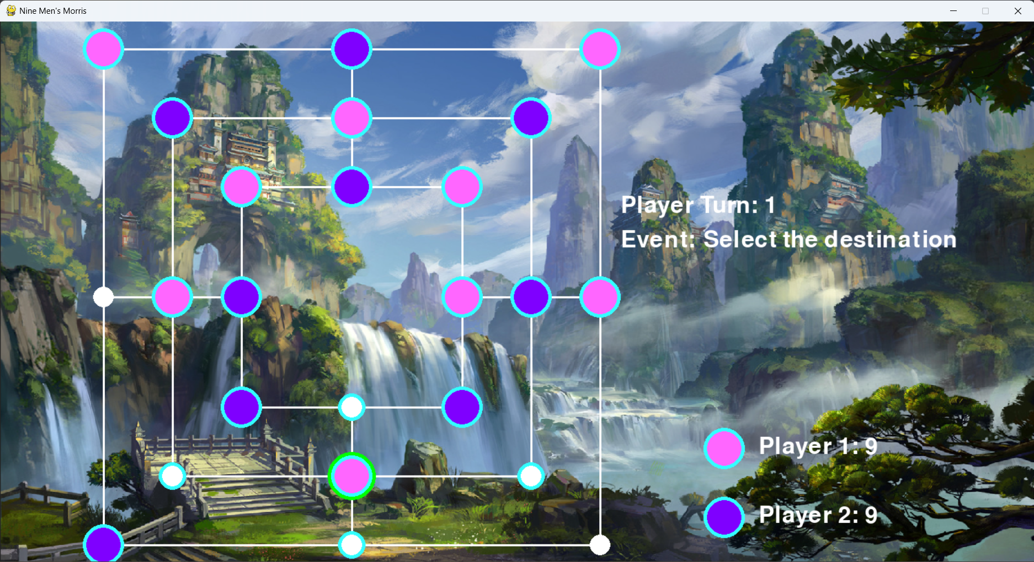
Game Window

Slide 5
Milestones
Placing of pieces and removal pieces is being executed perfectly according to the rules of the game.
Player Turn and Event to be done are shown on screen so players can clearly understand whose move has to be played and what kind of move should be done now.
During the moving phase, when a piece is selected to move, all of its possible movements are highlighted.
Mill made during a turn can remove the piece only once, to use it again, a new mill has to be formed.

Slide 6
Conclusion
In conclusion, developing the Nine Men's Morris game allowed me to integrate classic gameplay mechanics with unique visual elements, enriching the user experience. This project enhanced my skills in Python and Pygame, especially in creating interactive game logic and a thematic interface. Overcoming challenges in board design, piece movement, and win condition handling deepened my problem-solving abilities. While the game meets core functionality, future improvements could include animations and sound effects for added immersion. Overall, this project provided valuable insights into game development, and I’m eager to explore further enhancements.

